Slide 1
FracFocus Well & Chemical Usage Analysis
Chirality Case Study
Presenter - Pamela Odurukwe

Slide 2
Project Overview
What is Hydraulic Fracturing?
Hydraulic fracturing, commonly known as fracking, is a well-stimulation method in which a mixture of water, sand, and chemical additives is injected at high pressure into deep rock formations to create fractures. These fractures increase the rock's permeability, allowing trapped oil, natural gas, or brine to flow more freely into the wellbore.
This project analyzes hydraulic fracturing data to understand well performance, water usage, and chemical ingredient patterns across different operators, well types, and locations.
The objective was to transform raw data into an interactive Power BI dashboard that enables stakeholders to quickly identify operational trends, resource usage patterns, and high-performing wells.

Slide 3
Business Problem
Understand which wells are performing best
Monitor water consumption patterns
Track Mass ingredient usage
Compare operators and operational resource usage

Slide 4
Key Business Questions
Which wells demonstrate the strongest production performance over time?
What ingredients are most commonly used in hydraulic fracturing?
Which operators are responsible for the largest activity levels?
Are there observable trends in performance over time?
Which locations show the highest activities

Slide 5
Assumptions
Each well disclosure represents a unique operational record.
Water volume values are assumed to be correctly reported and comparable across wells.
Chemical ingredient mass represents the amount used per disclosure event.
Year fields represent the time of well activity

Slide 6
Data Ingestion and Storage
MySQL
Data Visualization and Insights
PowerBI
Reporting
PowerBI Service

Slide 7
Data Ingestion and Storage
The dataset was sourced from the http://fracfocus.org/data-download.
The ‘oil and gas data’ was downloaded as Microsoft Comma-Separated Values files in a Zip folder.
18 files
File category | Number of files | Rows | Columns
FracFocus Registry | 15 | 7,079,950 | 34
Disclosure List | 1 | 244,036 | 19
Water Source | 1 | 19,964 | 9
Readme csv | 1
MySQL was chosen as the preferred database because
Familiarity with MySQL-based data manipulation and querying
Efficient handling of large datasets
Ability to create structured views for analysis
Seamless integration with Power BI
Reliable relational data storage

Slide 8
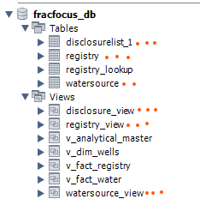
Data Ingestion and Storage Contd…
Database Creation
Data Import
Audit Trail Maintenance
Nomenclature consideration
Efficiency consideration
Table relationships (PK and FK)
Type Optimization
Foreign Key Indexing

Slide 9
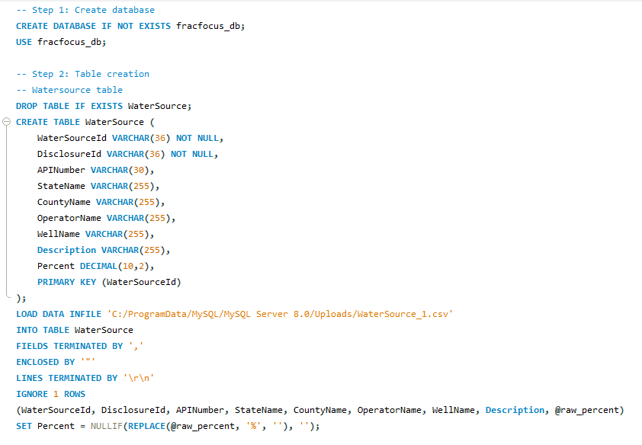
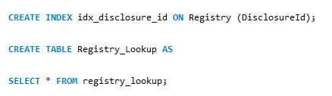
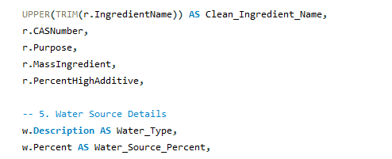
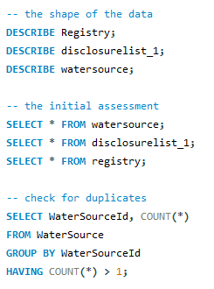
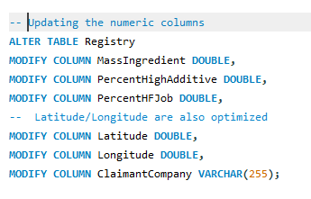
Data Ingestion and Storage Contd…

Slide 10
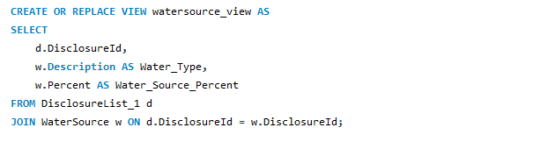
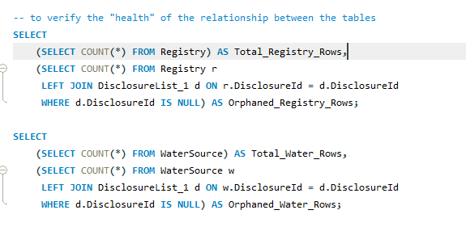
Data Ingestion and Storage Contd…

Slide 11
Data Ingestion and Storage Contd…
Initial Assessment/ Data Cleaning (Null Values, Standardization)
Views Creations
Data health verification

Slide 12
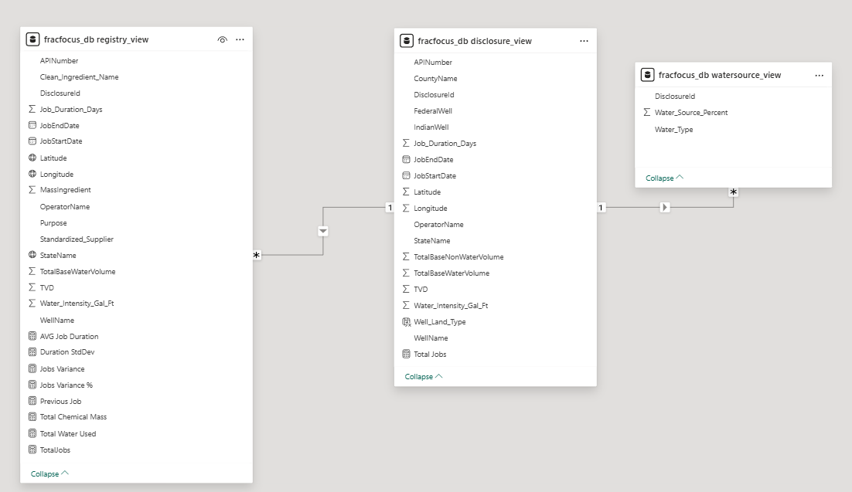
Data Visualization Architecture
Connected MySQL
Reviewed Data types
Table Relationships

Slide 13
Insights Generated
Water Usage Patterns
Groundwater with low salinity and produced water account for the largest share of water used in fracturing operations. This indicates that operators rely heavily on these sources to support hydraulic fracturing activities.
Chemical Usage Concentration
A small number of chemicals account for the majority of the total mass of ingredients used in fracturing fluids. Water remains the primary component, followed by additives such as methanol, hydrochloric acid, and sodium chloride, which play key roles in well stimulation and fluid performance.
Geographic Concentration of Activity
Operational activity is highly concentrated in a few states, with Texas significantly leading in both well activity and resource usage. Other states such as Oklahoma, Colorado, and North Dakota also contribute notable levels of activity but at a much smaller scale.
Well Performance and Depth Variation
Certain wells consistently show higher performance levels and deeper vertical depths compared to others. This may reflect differences in geological conditions, operational strategies, or drilling technologies.
Operator Dominance
Fracturing operations are dominated by a relatively small number of operators. Companies such as XTO Energy, Anadarko Petroleum, Pioneer Natural Resources, and Devon Energy account for a large share of wells, water usage, and chemical consumption.
.

Slide 14
Business Recommendations
Operational Benchmarking
High-performing wells and operators can be analyzed further to identify operational practices that contribute to stronger performance. These practices could potentially be replicated across other wells.
Regional Resource Planning
Since fracturing activity is concentrated in specific states, resource planning and infrastructure development should prioritize regions with the highest operational intensity.
Chemical Usage Monitoring
Monitoring the use of key chemical additives can help improve transparency in fracturing operations and support environmental compliance.
Operator Performance Benchmarking
Comparing operational metrics across major operators can reveal differences in efficiency, resource usage, and operational strategies. These insights can help identify industry best practices.

Slide 15
Automation and Scalability Considerations
To support ongoing analysis and future expansion:
Data pipelines could be automated using scheduled database updates
Power BI datasets can be configured with scheduled refresh
Additional datasets (production data, environmental metrics) could be integrated
Cloud storage solutions could support larger datasets

Slide 16
Challenges and Troubleshooting
Several challenges were encountered during the project.
Large Dataset Size
Data Type Inconsistencies
Aggregation Errors

Slide 17
Thank You

